Slide 1
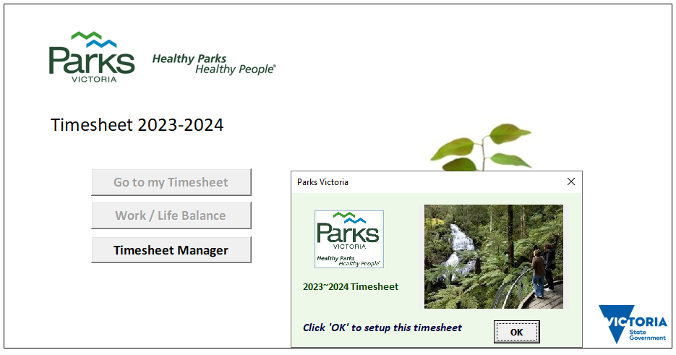
Parks Victoria Timesheet 2022-23
Administration Guide

Slide 2
Parks Victoria Timesheet 2022-23
Click Timesheet Manager to open the Administration Form

Slide 3
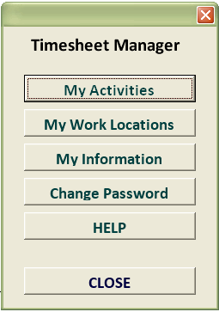
Parks Victoria Timesheet 2022-23
The Administration form appears

Slide 4
Parks Victoria Timesheet 2022-23
Click the ‘My Activities’ button to manage work activities within this timesheet

Slide 5
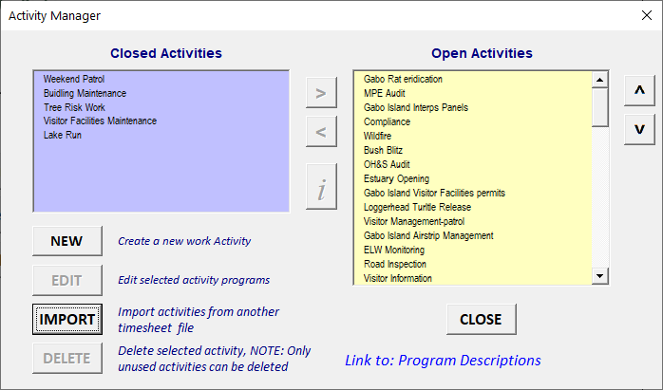
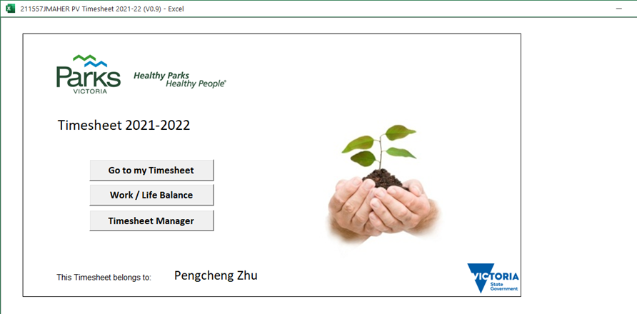
Parks Victoria Timesheet 2022-23
Managing Activities
The activities form opens showing ‘Open’ and ‘Closed’ activities
Open activities are the ones you see on the drop-down list when you enter work information in your timesheet. Closed activities are excluded from the drop-down list.

Slide 6
Parks Victoria Timesheet 2022-23
Managing Activities
To close an activity, select the activity in the ‘Open’ list then click the ‘<’ button

Slide 7
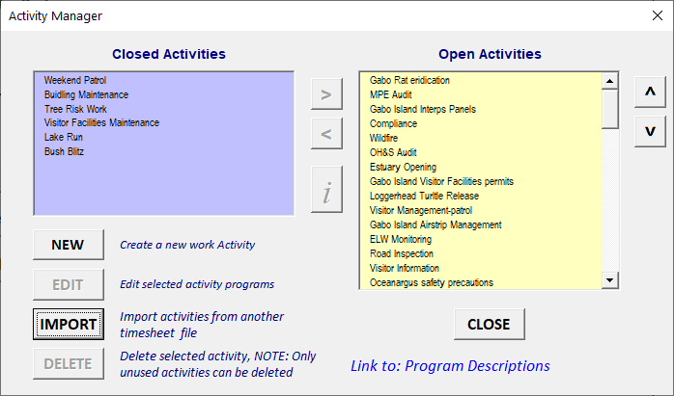
Parks Victoria Timesheet 2022-23
Managing Activities
The activity is removed from the ‘open’ list and added to the ‘closed’ list
(Similarly, to open an activity, select the activity in the ‘closed’ list then click ‘>‘)

Slide 8
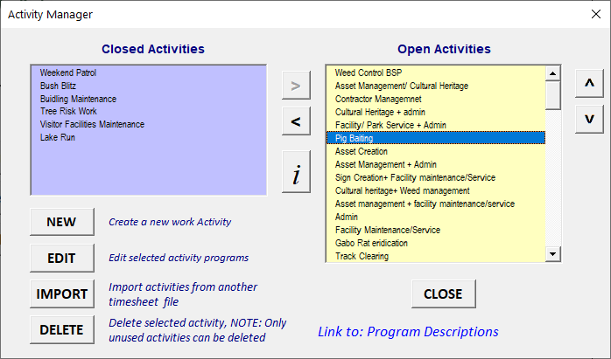


Parks Victoria Timesheet 2022-23
Managing Activities
Sort the activities using the up and down arrows The activities will appear in this order on your timesheet

Slide 9
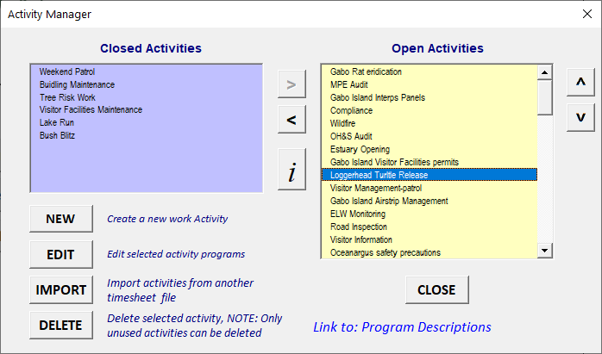
Parks Victoria Timesheet 2022-23
Managing Activities
To see the Programs associated with an activity, select the activity, then click the ‘information’ button.

Slide 10
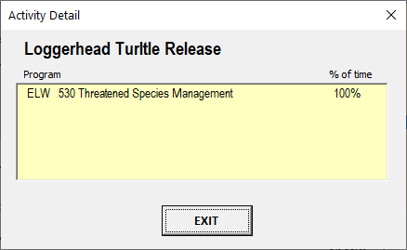
Parks Victoria Timesheet 2022-23
Managing Activities
… an information form opens showing the programs and percentage of time allocated to each program.

Slide 11
Parks Victoria Timesheet 2022-23
Managing Activities
You can import activities from another timesheet by clicking the ‘IMPORT’ button.

Slide 12
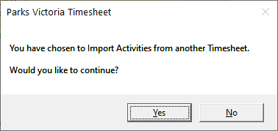
Parks Victoria Timesheet 2022-23
Managing Activities
You will be asked to confirm you want to import activities, then…

Slide 13
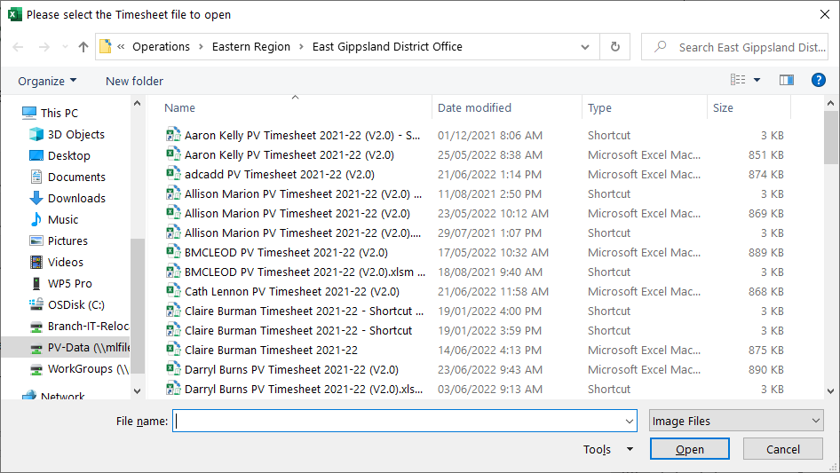
Parks Victoria Timesheet 2022-23
Managing Activities
Select the timesheet file to import from then click ‘Open’

Slide 14
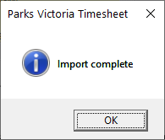
Parks Victoria Timesheet 2022-23
Managing Activities
You will be notified when the import function has completed.
The imported activities will be displayed in the ‘Open Activities’ list.

Slide 15
Parks Victoria Timesheet 2022-23
Creating a New Activity
To delete an activity, select the activity to delete … then click the ‘Delete’ button.
NOTE: Only activities that have not been used in your timesheet can be deleted.

Slide 16
Parks Victoria Timesheet 2022-23
Creating a New Activity
To create a new activity, click the ‘NEW’ activity button….

Slide 17
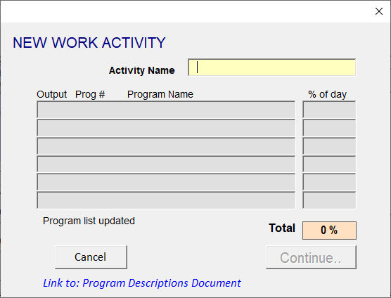
Parks Victoria Timesheet 2022-23
Creating a New Activity
The New Work Activity form is displayed.

Slide 18
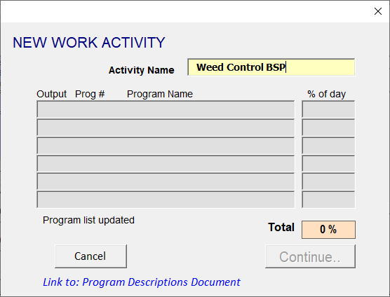
Parks Victoria Timesheet 2022-23
Creating a New Activity
Enter a descriptive name for the new activity
NOTE: If the activity name already exists, you will be notified and will have to enter a different name.

Slide 19
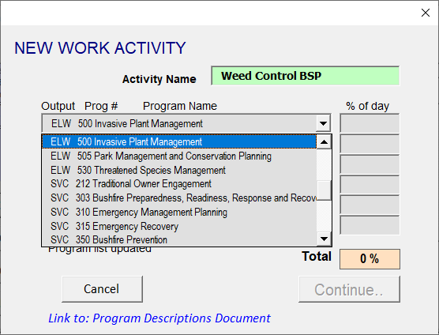
Parks Victoria Timesheet 2022-23
Creating a New Activity
Choose a Program from the Program list…..

Slide 20
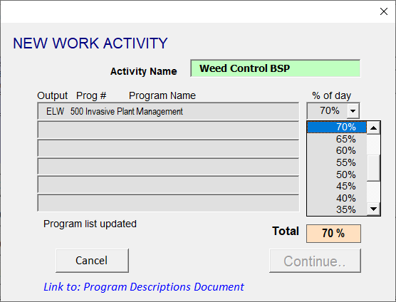
Parks Victoria Timesheet 2022-23
Creating a New Activity
… then select the amount of time allocated to the program as a percentage of total

Slide 21
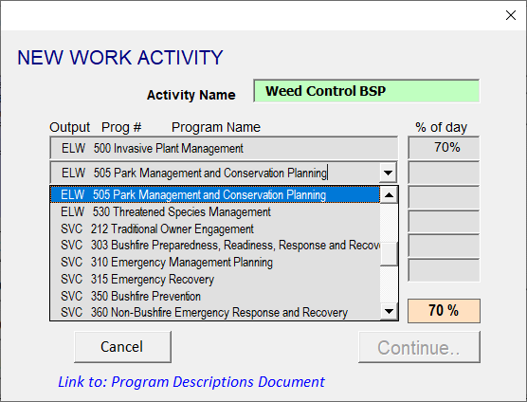
Parks Victoria Timesheet 2022-23
Creating a New Activity
Continue to select program names ….

Slide 22
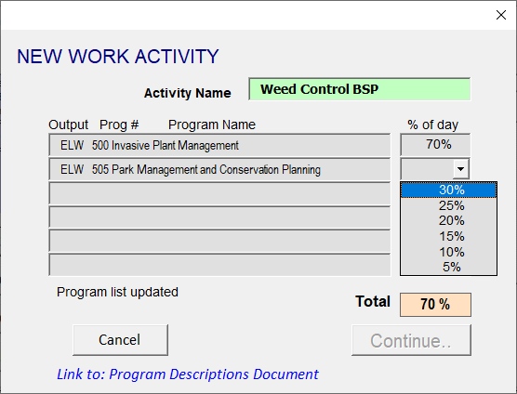
Parks Victoria Timesheet 2022-23
Creating a New Activity
… and the percentage of time

Slide 23
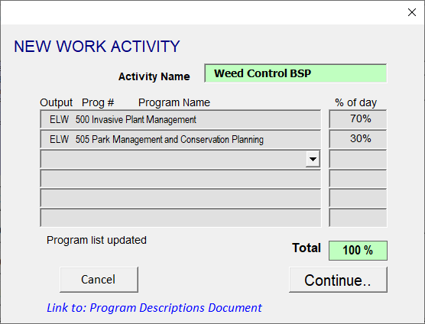
Parks Victoria Timesheet 2022-23
Creating a New Activity
…until 100% of the total time has been allocated. Then click ‘Continue..’

Slide 24
Parks Victoria Timesheet 2022-23
Creating a New Activity
If you need help with Program information, click on the link….

Slide 25
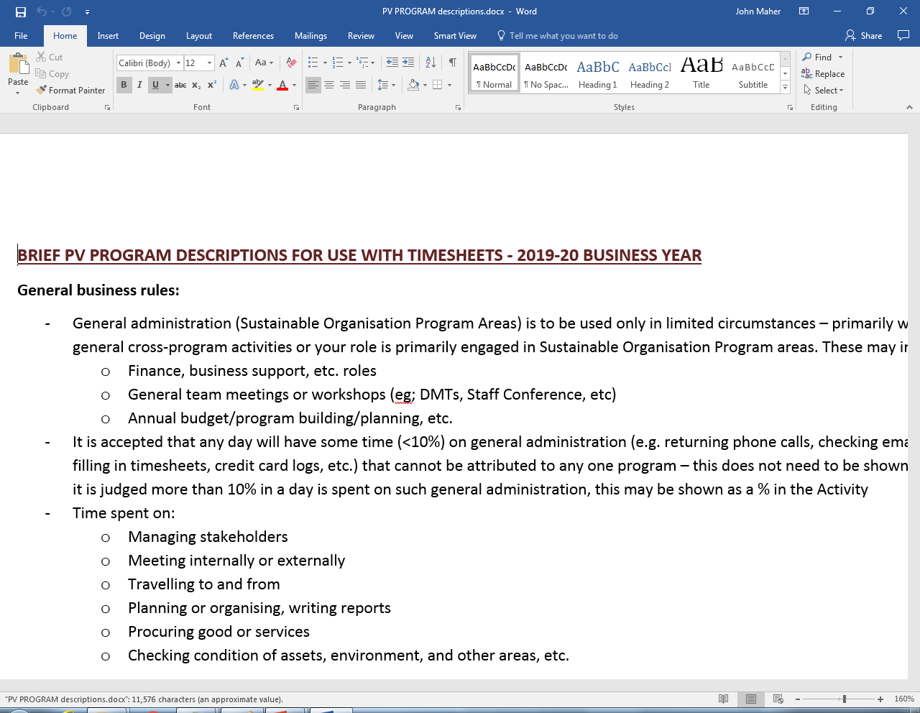
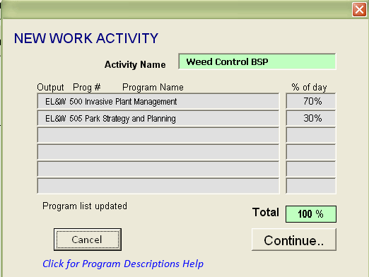
Parks Victoria Timesheet 2022-23
Creating a New Activity
… to open the Program Descriptions help document

Slide 26
Parks Victoria Timesheet 2022-23
Creating a New Activity
To EDIT a selected activity, click the “EDIT” button.

Slide 27
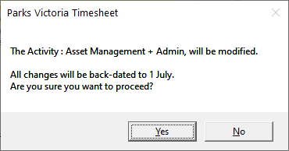
Parks Victoria Timesheet 2022-23
Creating a New Activity
Please note, all changes to the Activity will be back-dated to the 1st of July 2018
A message will appear asking you to confirm your action.
Click ‘Yes’ to continue to the ‘Edit Activity’ form

Slide 28
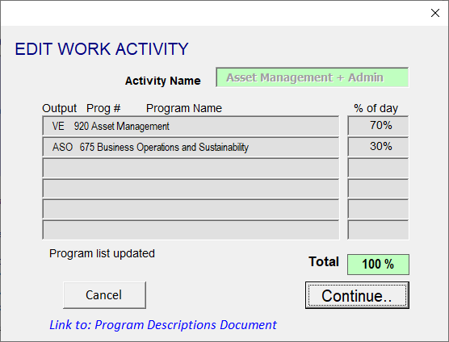
Parks Victoria Timesheet 2022-23
Creating a New Activity
The ‘Edit Work Activity’ form allows you to change Programs and percentages for the Activity. Click ‘Continue’ when you have made your changes.

Slide 29
Parks Victoria Timesheet 2022-23
Click ‘My Work Locations’ to view and change your work locations list

Slide 30
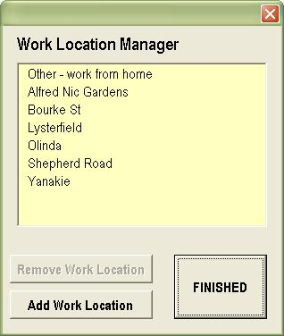
Parks Victoria Timesheet 2022-23
Managing Work Locations
The ‘Work Location Manager’ form is displayed.

Slide 31
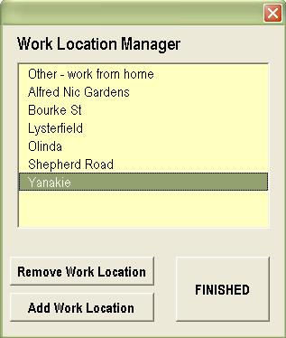
Parks Victoria Timesheet 2022-23
Managing Work Locations
To remove a location from your work locations list, select the location then click ‘Remove Work Location.

Slide 32
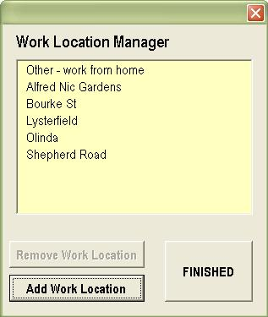
Parks Victoria Timesheet 2022-23
Managing Work Locations
…the work location is removed. To add a location, click the ‘Add Work Location’ button.

Slide 33
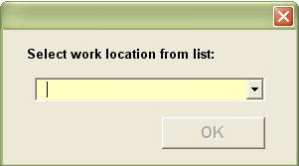
Parks Victoria Timesheet 2022-23
Managing Work Locations
…the ‘Select work location’ form is Displayed..

Slide 34
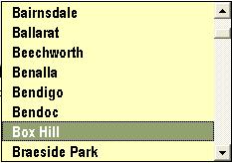
Parks Victoria Timesheet 2022-23
Managing Work Locations
…select the work location from the drop-down list…..

Slide 35
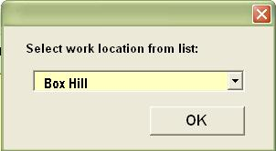
Parks Victoria Timesheet 2022-23
Managing Work Locations
…then click ‘OK’ to add the new work location to your location list.

Slide 36
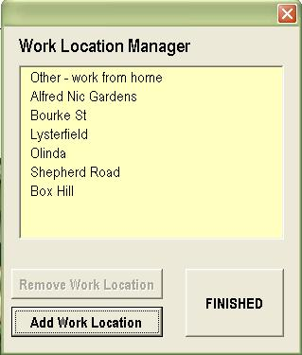
Parks Victoria Timesheet 2022-23
Managing Work Locations
Click the ‘FINISHED’ button when your work location list is correct.

Slide 37
Parks Victoria Timesheet 2022-23
Click ‘My Information’ to see your personal information.

Slide 38
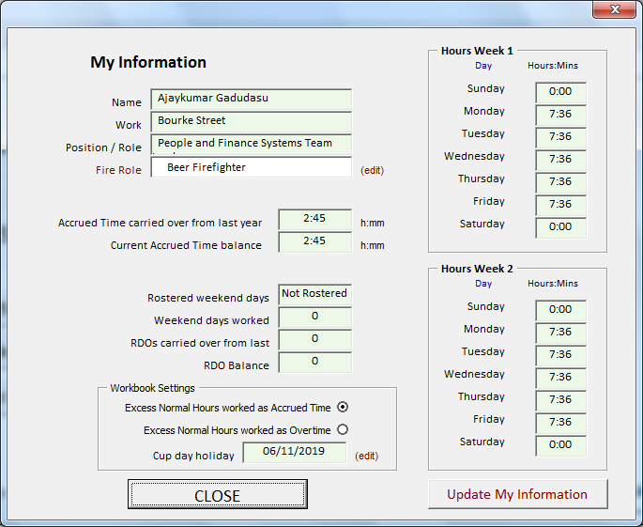
Parks Victoria Timesheet 2022-23
This form is for your information. You can only change the ‘Workbook settings’ and Fire Role.
If your work arrangement has changed, click ‘Update My Information’ and your new work-plan will be retrieved from the FaP system and displayed on the form.
2022 dates can be found at business.vic.gov.au when confirmed

Slide 39
Parks Victoria Timesheet 2022-23
Click the ‘Change Password’ button to change your password.

Slide 40
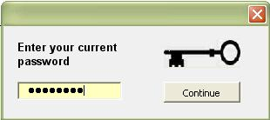
Parks Victoria Timesheet 2022-23
Change password
Enter your current password, then ….

Slide 41
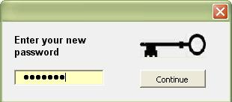
Parks Victoria Timesheet 2022-23
Change password
…enter your new password, then ….

Slide 42
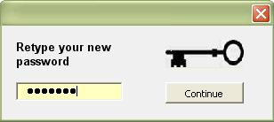
Parks Victoria Timesheet 2022-23
Change password
… confirm your new password. Click Continue.. and your password will be changed

Slide 43
Parks Victoria Timesheet 2022-23
Click ‘CLOSE’ to close the Timesheet Manager

